Slide 1

Flood mapping using cloud computing platform and machine learning
Naledi Manyaka
MSc Environmental and Water Science
3950092@myuwc.ac.za
Supervisor: Prof T. Dube
Co-Supervisor: Dr. S. Gxokwe

Slide 2
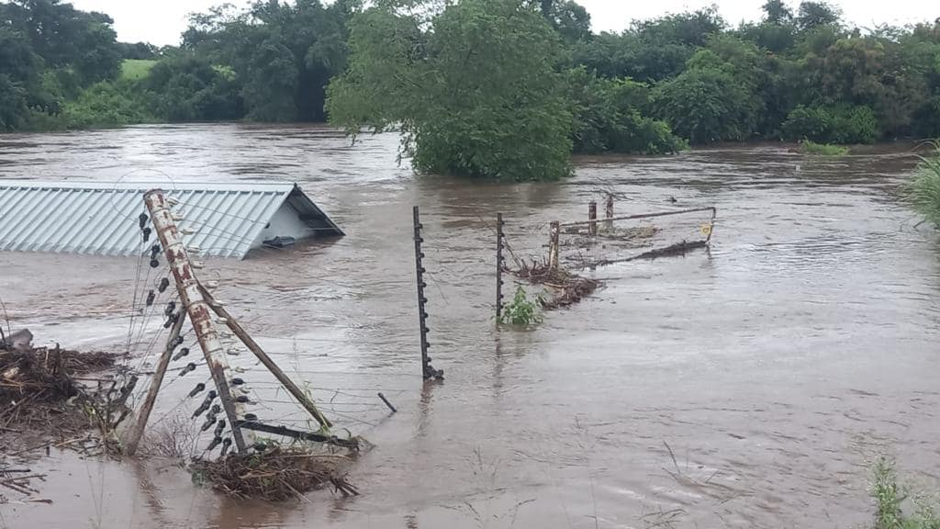
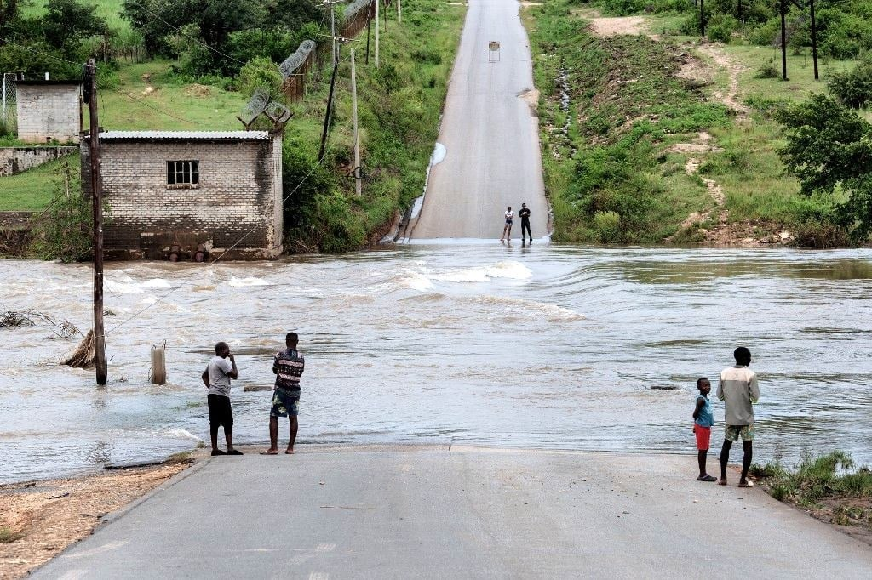
Introduction
Flooding is a natural disaster that continues to pose significant threats to human life, property, and the environment.
Floods are natural disasters that occur in various regions, both in urban and rural areas. Their impacts include economic losses, environmental damage, and loss of life.
Floods are the most frequent and costly natural disasters worldwide​
Climate change is increasing flood frequency and severity
Accurate flood modeling and early warning systems are critical for effective disaster management, risk assessment, and mitigation strategies

Slide 3

Literature
There is a lack of proper mechanisms for advanced flood risk modelling, real-time monitoring, and efficient early warning systems to mitigate the consequences of floods in developing regions.
In flood risk mapping, most studies use Optical remotely sensed data such as Landsat series amongst others. However, cloud cover is a major challenge when using optical imageries.
Traditional flood modelling methods have limitations (Data scarcity, computational intensity)​
Limited accessibility in remote areas: Challenging terrains, hinder the implementation of conventional mapping techniques.​
Cloud cover and visibility issues: Cloud cover often obstructs Optical satellite imagery during heavy rains, rendering it ineffective.
Availability of cloud computing platforms have revolutionized the use of SAR in flood mapping, with its advanced data analytics tools such as machine learning algorithms as well as access to extensive repository of SAR data, near-real time monitoring of flooding events is possible. However, according to our knowledge the platform has also not been fully explored in terms of its capabilities in mapping flood risks and extents in sub-Saharan Africa

Slide 4
Aim
To utilize the extensive capabilities of Google Earth Engine for conducting large-scale geospatial analyses and detailed flood risk modeling ​
To perform a thorough assessment of various multi-source spatial datasets (DEM, rainfall data, LULC) to determine their collective impact on flooding trends and patterns in the area.​
To perform interannual flood extent mapping over multiple years (2020-2024).

Slide 5
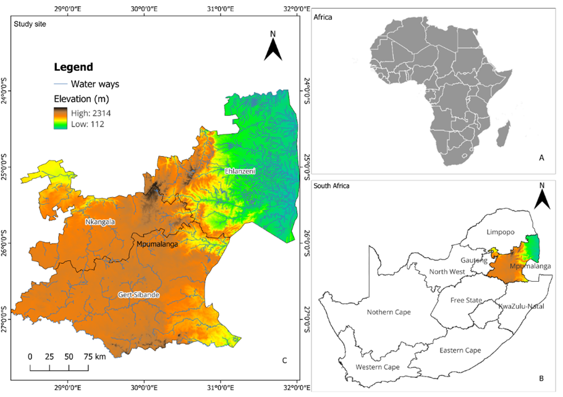
Study area
Surface area of 76,495 km².
Bordered by Limpopo to the north, Mozambique and Eswatini to the east, Gauteng and Free State to the west, and KwaZulu-Natal to the south
Rainfall - summer months (October – April).
The mean annual rainfall - 400 mm and 1,500 mm.
The topography of the Mpumalanga region is diverse (Highveld, Middle veld & lowveld)

Slide 6
Dataset
Dataset ​ | Spatial/Temporal Resolution​ | Purpose​ | Source​
Sentinel-1A (SAR)​ | 10m, 12 days​ | Flood extent mapping​ | ESA​
Landsat-8 (OLI)​ | 30m, 16 days​ | Pre-flood images​ during-flood images​ for validation​ | Earth Explorer​
CHIRPS: Rainfall​ | 5.5 km x 5.5km, 1-2 weeks​ | Rainfall distribution​ Rainfall anomaly​ | ​Google Earth Engine
Sentinel-2 Copernicus​ Land Cover​ | 10m, 6 days​ | Affected LULC extraction​ | ESA​

Slide 7
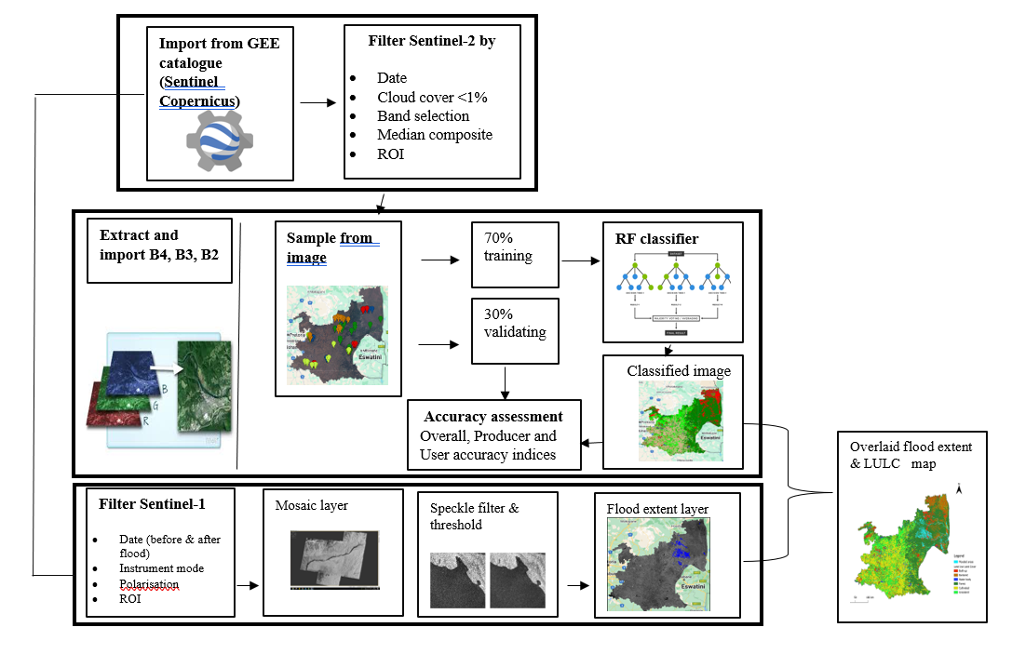
Methodology

Slide 8
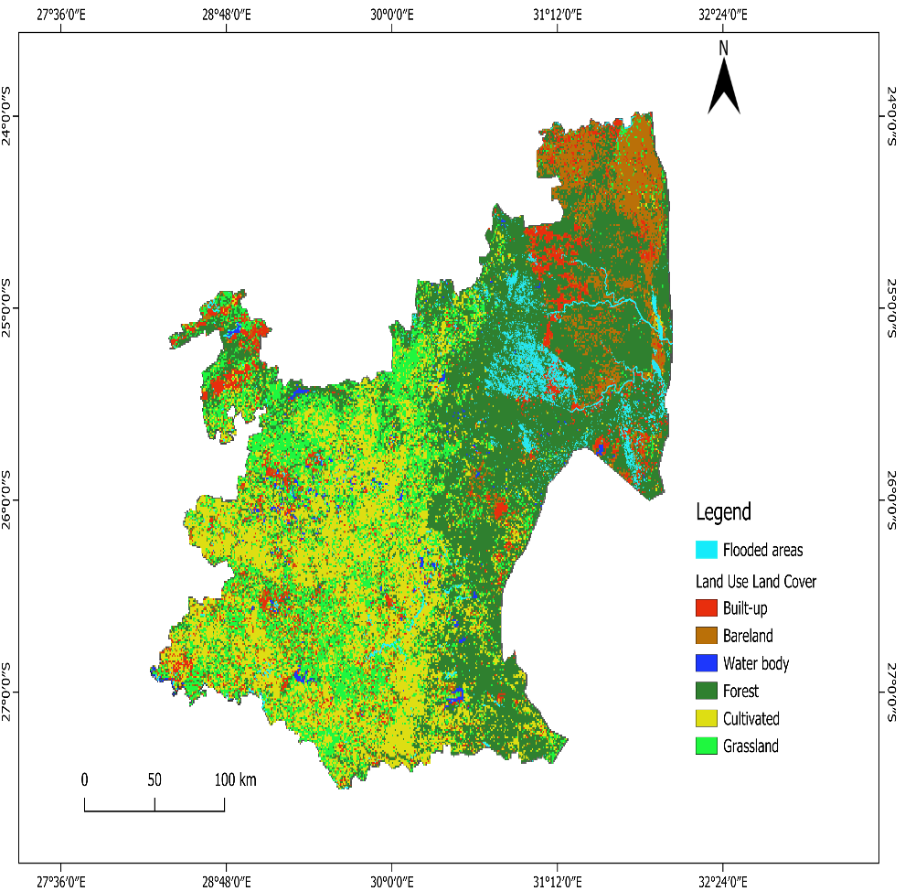
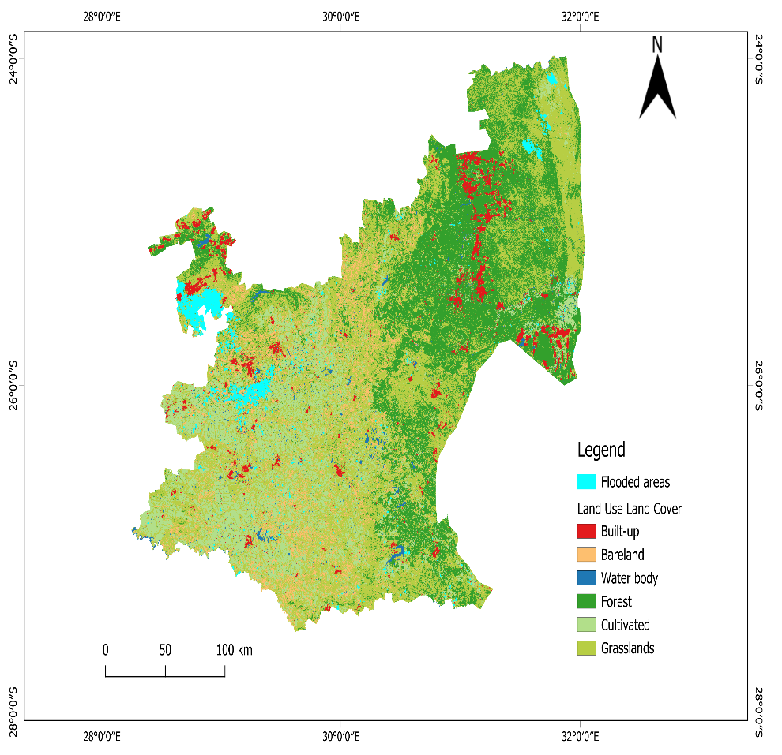
Results and discussion
A
B
Key findings
A shows flood extent overlayed on LULC map for February 2023 (543.18 km² (0.71%) of the province) and B show flood extent for March 2023 (1912.38 square kilometer, 2,5%)

Slide 9
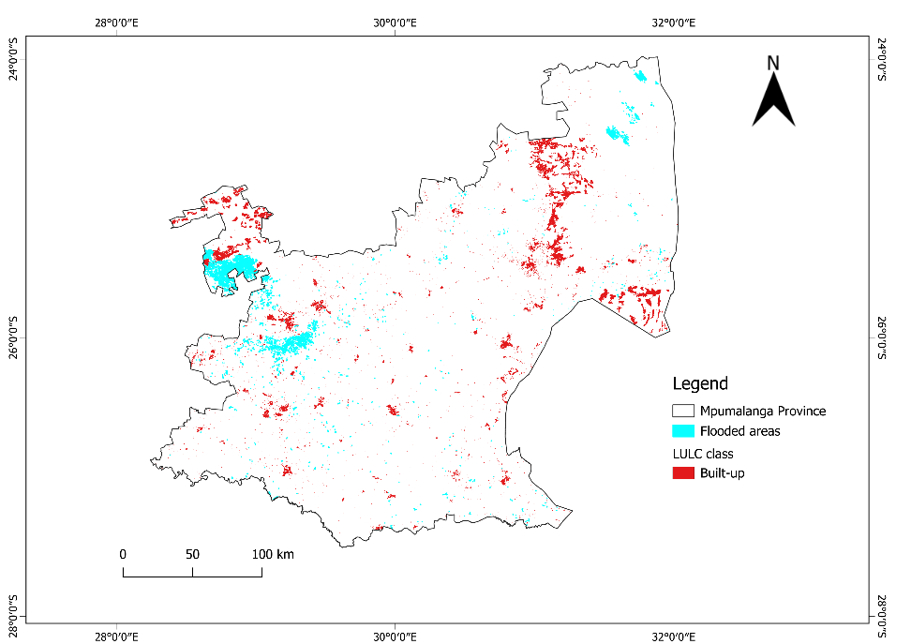
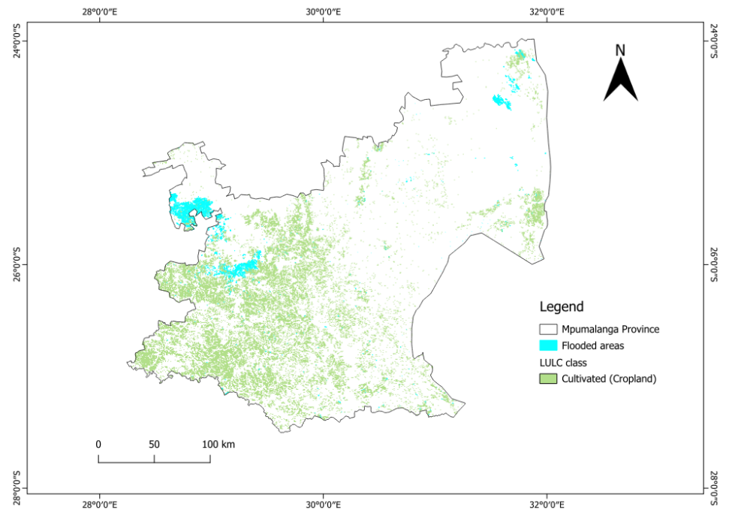
Land Use Land Cover damage assessment
A
B
 | Built-up (ha) | Cropland (ha)
Damage assessment | 10056 | 25844

Slide 10
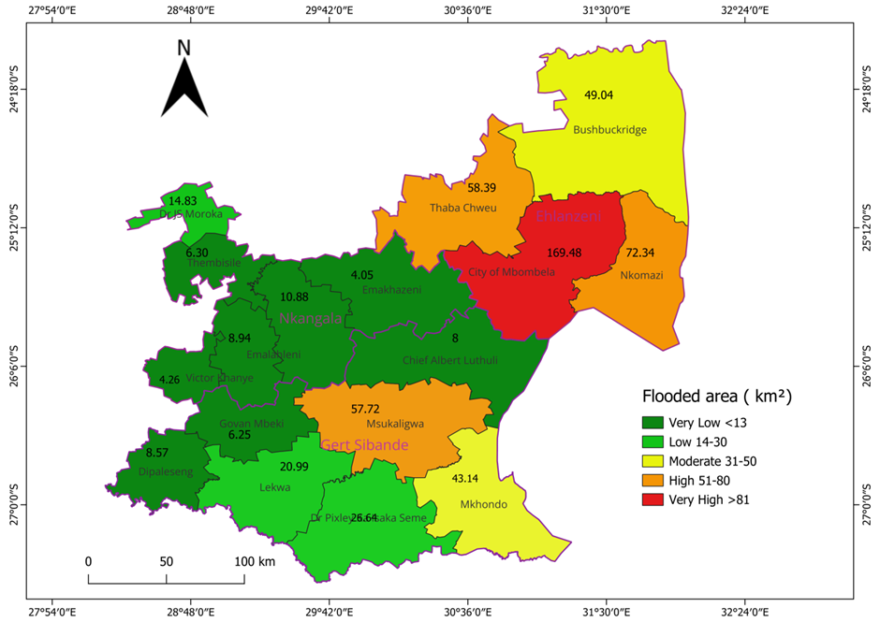
Flood/Rainfall analysis
A
Key Results
The analysis shows that districts such as Ehlanzeni and parts of Nkangala and Gert Sibande were most affected by flooding, primarily due to their low elevation and high rainfall accumulation
The results demonstrate a clear relationship between flood extent and high-intensity precipitation
543.18 km² (0.71% of the province) for February 2023

Slide 11
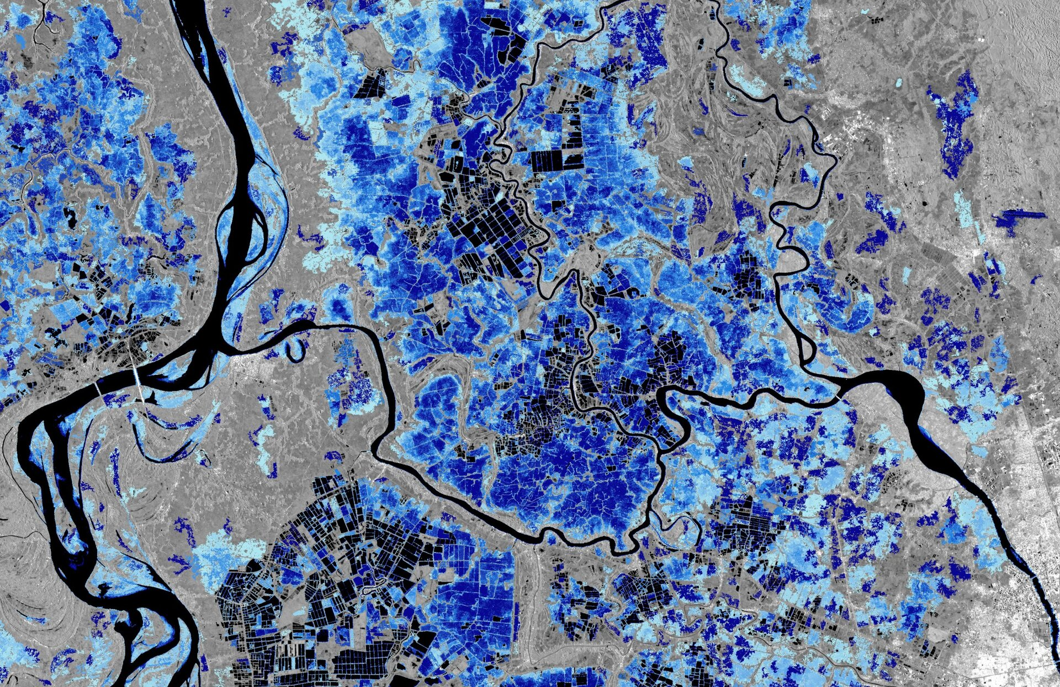
Conclusion
The identification of flood-prone zones and the correlation with rainfall and land cover classes provide actionable insights for disaster risk management, urban planning (SDG 11), and infrastructure development.
The findings support progress toward Sustainable Development Goals 13, 11 and 6 by enhancing understanding of flood hazards intensified by climate change and promoting the sustainable management of water and resilience to water-related disasters.
The approach presented can be replicated in other vulnerable areas to strengthen climate adaptation efforts.

Slide 12
Thank you!

